Slide 1



MealMap A Smarter Way to Eat Healthy and Stay Balanced

Slide 2
MealMap A Smarter Way to Eat Healthy and Stay Balanced
Notes:
NOTE: To replace a picture, just select and delete it. Then use the Insert Picture icon to replace it with one of your own!

Slide 3

Contributors
Md.Zahid Hasan - 21225103407 Mst. Sangida Afrin Niha – 21225103201 Md.Ebrahim Hossain - 21225103424 Md.Samiullah Mahmud - 21225103247

Slide 4

Table of Content
Abstract
Introduction
Key Features of MealMap
Problem Statement
Problem Solution
Functionality
Market Analysis
Revenue Generation
Revenue Projection
Start-Up Plan
Challenges
Technologies
User Experience
Conclusion

Slide 5
Abstract
MealMap is a digital platform designed to simplify meal planning and nutritional management for busy lifestyles. It integrates personalized meal plans, recipe suggestions, grocery organization, and nutritional tracking into one user-friendly solution. This presentation provides a comprehensive overview of the system, its objectives, technical design, and potential impact

Slide 6
Introduction
MealMap is an innovative digital platform designed to address the growing need for personalized meal planning and nutritional management. As lifestyles become busier and dietary needs more complex, individuals and families seek effective tools to simplify meal planning, enhance nutrition, and support healthy living. MealMap aims to fill this gap by providing a user-friendly platform that integrates meal planning, recipe suggestions, grocery management, and nutritional tracking into one comprehensive solution

Slide 7
Key Features of MealMap
Personalized Meal Planning: Tailored meal suggestions based on user preferences and health goals.
Recipe Database: A wide selection of recipes with filtering options for dietary needs.
Grocery List Automation: Auto-generates grocery lists integrated with local stores.
Nutritional Tracking: Real-time tracking of calories and nutrients.
Meal Calendar: Plan meals for the week with a calendar view.
Educational Content: Access to nutrition and cooking tips.
User Profiles: Customizable profiles for dietary preferences and restrictions.
Recipe Sharing: Share meals and tips with others.
Fitness Integration: Syncs with fitness apps to track nutrition and activity.
Multi-Device Access: Access from smartphones, tablets, and desktops.
These features simplify meal planning, grocery shopping, and healthy living.

Slide 8
Problem Statement
In today's fast-paced world, many individuals struggle with maintaining a balanced diet due to a lack of time, knowledge, and resources. Traditional meal planning methods are often cumbersome and inefficient, leading to poor dietary choices and increased food waste. Furthermore, existing solutions lack personalization and fail to address specific dietary needs and preferences. MealMap seeks to resolve these issues by offering an intuitive platform that simplifies meal planning, provides tailored recommendations, and tracks nutritional intake to support healthier lifestyles. Objectives

Slide 9
Problem Solution
MealMap is a dynamic platform that simplifies meal planning by offering personalized meal suggestions, efficient grocery list management, and nutritional tracking. By integrating user profiles, dietary preferences, and health objectives, MealMap trailors meal plans, streamlines shopping through automated grocery lists, and provides educational resources on healthy eating. This solution enhances users' ability to maintain a balanced diet, reduce food waste, and achieve their health goals in a convenient and efficient way.

Slide 10
Functionality
•User Profiles: Users can create and manage profiles, including dietary preferences, restrictions, and health objectives.
•Recipe Database: Access a comprehensive database of recipes, with filtering options for dietary needs, cuisine, and difficulty.
•Meal Planning Tools: Use drag-and-drop functionality to plan meals for the week, with calendar integration.
•Grocery List Automation: Automatically generate grocery lists based on selected meals and recipes, with options for online shopping integration.
•Nutritional Analysis: Track and analyze daily nutritional intake, with visual reports and recommendations.
•Educational Resources: Access articles, videos, and tips on healthy eating and cooking techniques

Slide 11
Market Analysis
With a growing middle class, urbanization, and increasing health awareness, Bangladesh presents a promising market for MealMap. The demand for personalized meal planning and nutritional solutions is fueled by busy lifestyles, rising internet penetration, and smartphone usage.
Key Insights:
Urban professionals and families are the primary target audience.
Growing adoption of food delivery apps and online grocery shopping indicates readiness for a platform like MealMap.
Rising awareness of diet-related health issues supports the need for nutritional tracking and planning tools.

Slide 12
Revenue Generation
MealMap will employ the following revenue streams tailored to the Bangladeshi market:
Subscription Plans:
Free tier for basic features to attract users.
Premium tier priced at BDT 500/month or BDT 5,000/year for advanced features like nutritional analysis and grocery integration.
Partnership Commissions:
Collaborations with local grocery delivery services like Chaldal or Foodpanda Grocery.
Partnerships with fitness centers and dietitians for additional commissions.
Advertisement Revenue:
Ads from local food brands, health products, and wellness services.
Affiliate Marketing:
Partnerships with local kitchen appliance stores and organic food suppliers.
Merchandise Sales:
MealMap-branded recipe books and kitchen tools tailored for Bangladeshi cuisine.

Slide 13
Revenue Projections
MealMap is positioned to succeed in Bangladesh by addressing the need for affordable,localized,and healthfocused meal planning solutions.
Revenue Source | Year 1 | Year 3 | Year 5
Subscription Plans | BDT 15,00,000 | BDT 50,00,000 | BDT 1,00,00,000
Partner Commissions | BDT 5,00,000 | BDT 15,00,000 | BDT 30,00,000
Advertisement Revenue | BDT 2,00,000 | BDT 10,00,000 | BDT 20,00,000
Affiliate Marketing | BDT 1,00,000 | BDT 5,00,000 | BDT 10,00,000
Merchandise Sales | BDT 2,00,000 | BDT 7,00,000 | BDT 15,00,000
Total Revenue | BDT 25,00,000 | BDT 87,00,000 | BDT 1,75,00,000

Slide 14


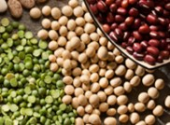

Start-Up Plan
Phase 1 (Months 1-3):
Finalize platform design and features based on market research.
Develop a prototype and conduct user testing with a focus group.
Phase 2 (Months 4-6):
Launch beta version to a limited user base.
Begin partnerships with local grocery delivery services and fitness brands.
Phase 3 (Months 6-12):
Full launch, including marketing campaigns and user onboarding.
Ongoing support and updates based on user feedback.

Slide 15
Technologies
Frontend: HTML,CSS,
Backend: MySQL,JavaScript,Php.
Other technologies: PC,Laptop.

Slide 16
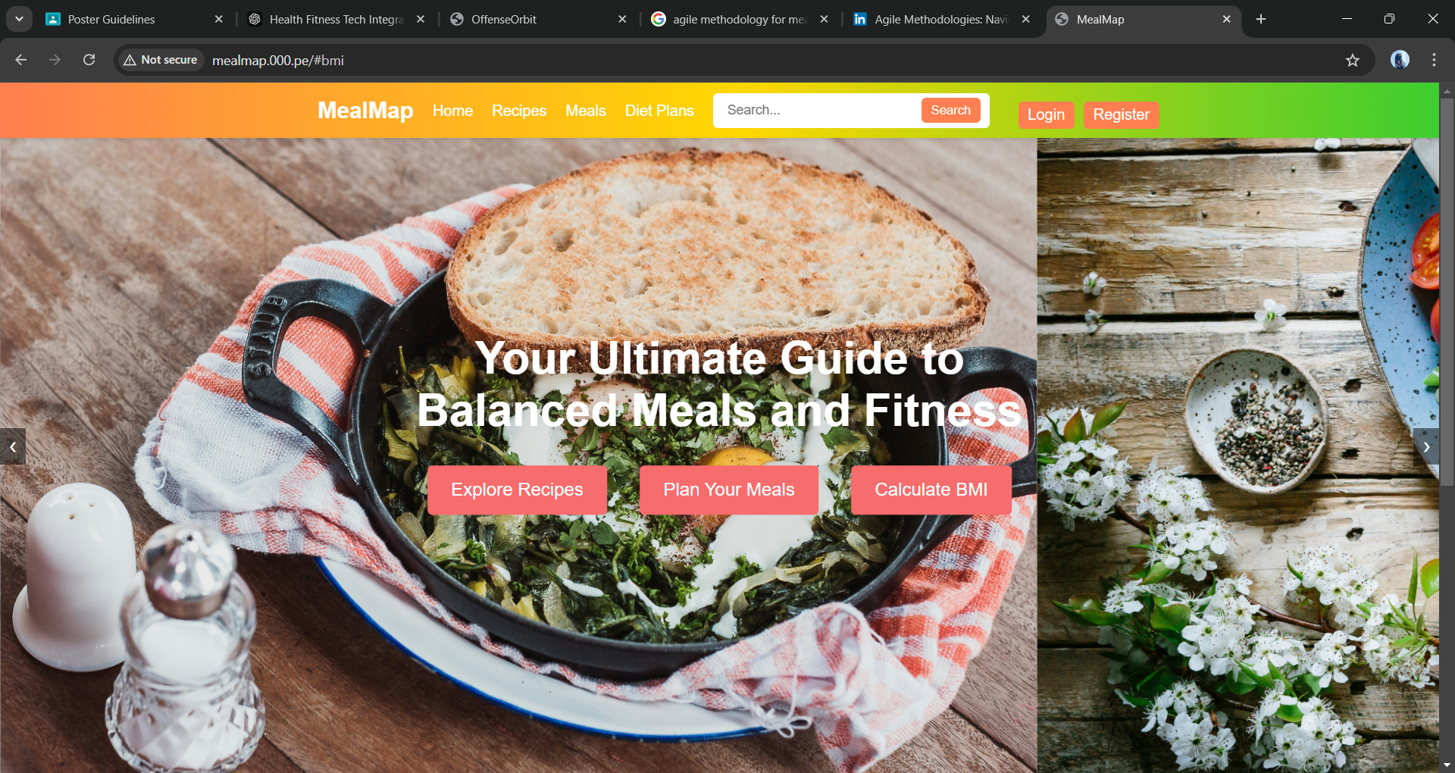
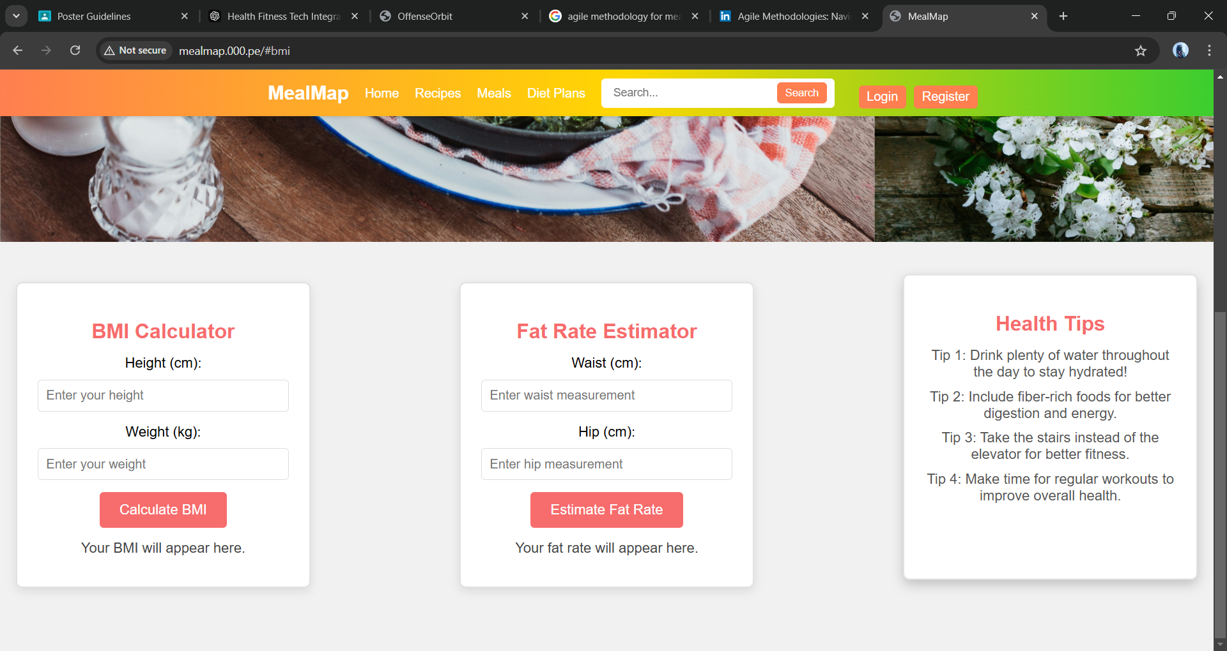
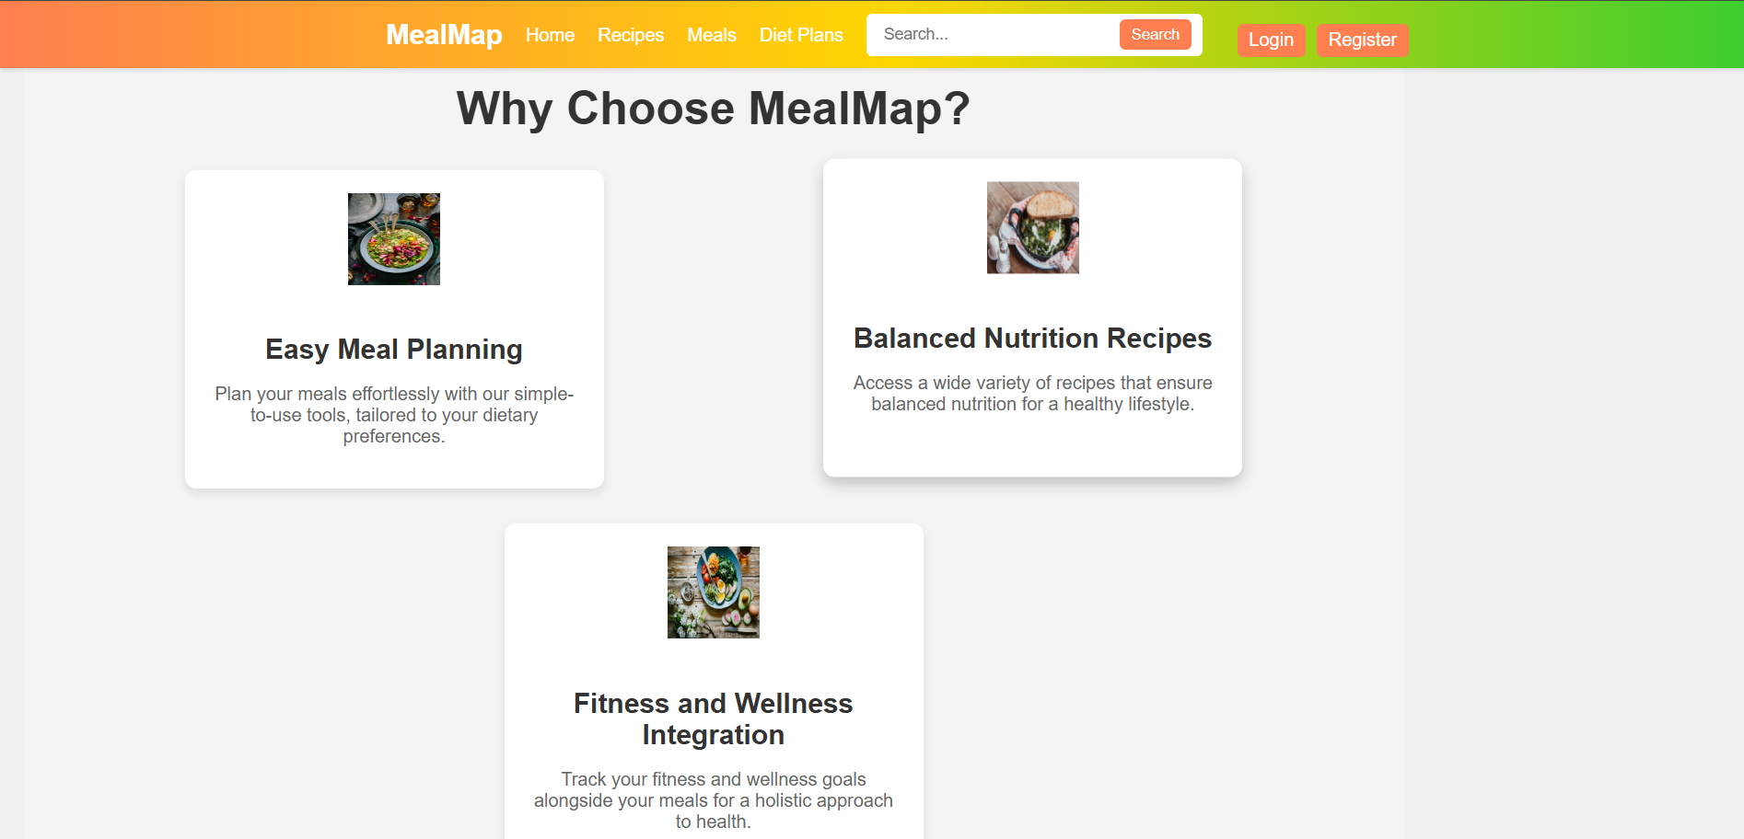
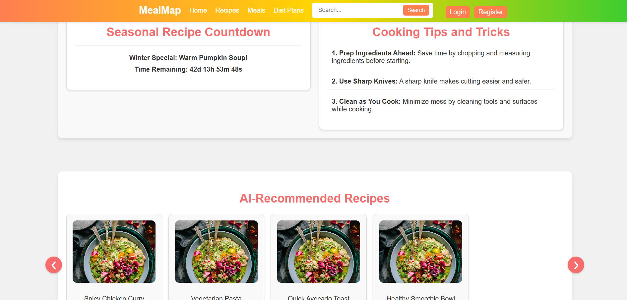
Homepage Dashboard

Slide 17
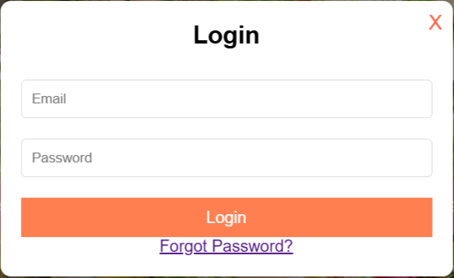
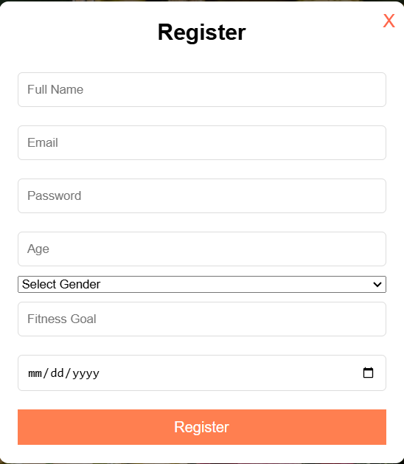
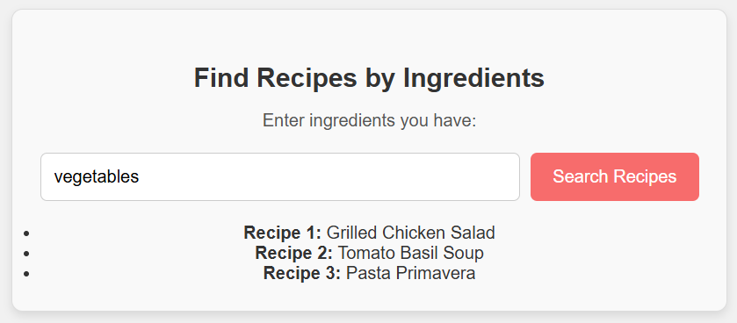
Interfaces

Slide 18




Challenges
Market Competition: Established meal delivery and recipe platforms may present significant competition, making user acquisition challenging.
User Trust: Building trust, especially around personalized recommendations and nutritional tracking, will require consistent quality and transparency.
Cultural Adaptation: Adapting the platform to local dietary preferences and integrating regional grocery stores and ingredients.
Internet Accessibility: Ensuring the platform is accessible to a wider population, particularly in rural areas with limited internet connectivity.

Slide 19
User Experience
Onboarding: Simple sign-up process allowing users to input dietary preferences, restrictions, and goals.
Meal Planning: Drag-and-drop functionality to plan meals and integrate with local grocery stores for seamless shopping.
Nutritional Tracking: Easy-to-understand visual reports for calories, macronutrients, and micronutrients.
Personalization: Tailored recipe suggestions based on user input and past preferences.
Support: In-app chat support and educational resources for cooking tips and nutrition advice.

Slide 20
Conclusion
MealMap aims to revolutionize meal planning and nutritional management by providing a comprehensive, user-friendly platform. With its focus on personalization, automation, and education, MealMap is well-positioned to meet the needs of today’s health-conscious consumers. The proposed methodology, budget, and feasibility analysis support the viability of the project, making it a promising investment in enhancing healthier living through technology.

Slide 21

Thank you
If you have any quarries , you can ask us.
Or
Connect with us!
Website address : mealmap.000.pe

